Slide 1

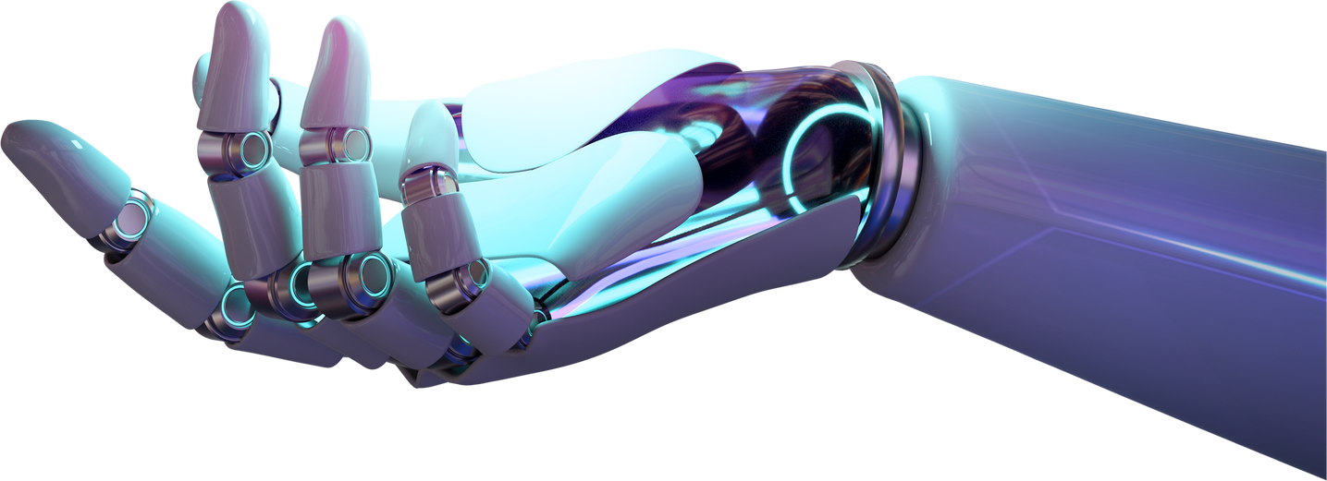
Borcelle
AUTISM
DETECTION
AHMED HAMDY
-
-
Page 01

Slide 2

🧩 Introduction to Autism
Autism, or Autism Spectrum Disorder (ASD), is a complex neurodevelopmental condition characterized by differences in communication, behavior, and social interaction. It affects individuals in diverse ways, with symptoms ranging from subtle challenges to significant support needs. Autism is not a disease to be cured, but a spectrum of unique cognitive profiles that shape how people perceive and engage with the world

Slide 3
Executive Summary of Methodology
Data Collection 🧪
Data Wrangling🧹
Data PreProcessing⚙️
•Exploratory Data Analysis📊
•🤖 Machine Learning Model
Neural Network🧬

Slide 4
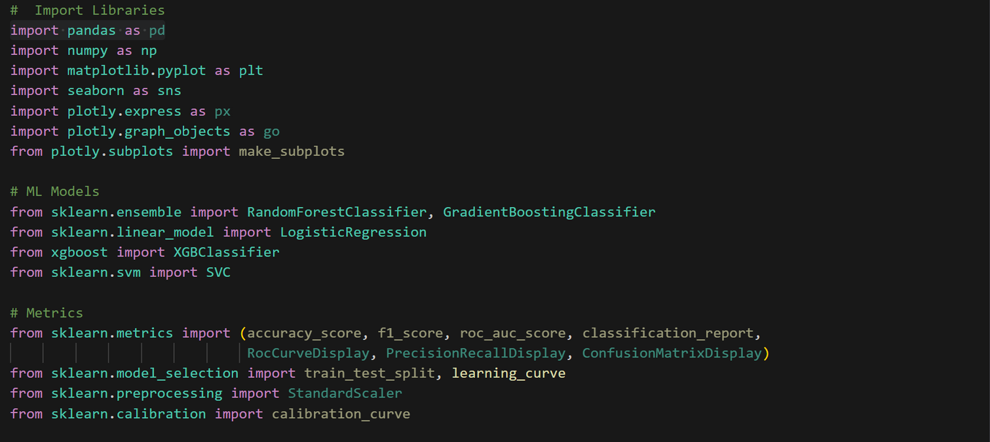
Import Libraries

Slide 5
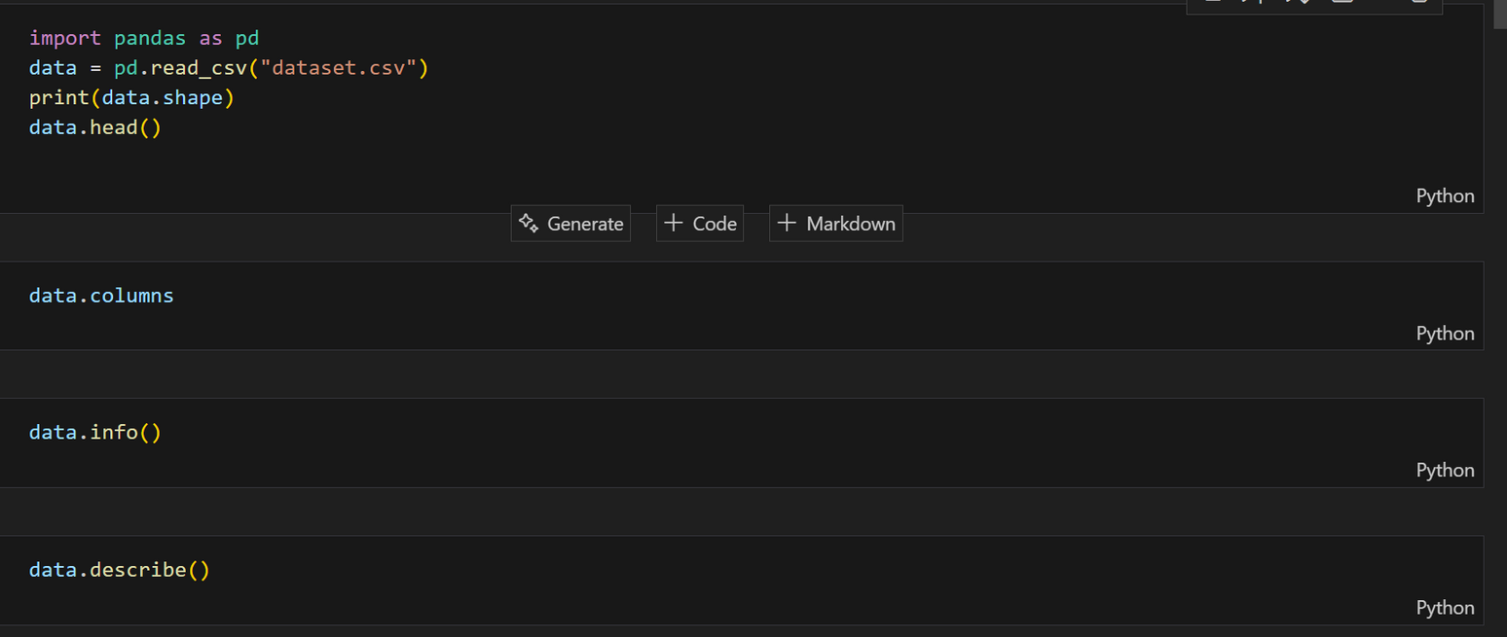
Data Collection
1-Use Kaggle.com:https://www.kaggle.com/competitions/autismdiagnosis
2-DownLoad the csv and Read csv by using pandas as pd and Explory Data

Slide 6
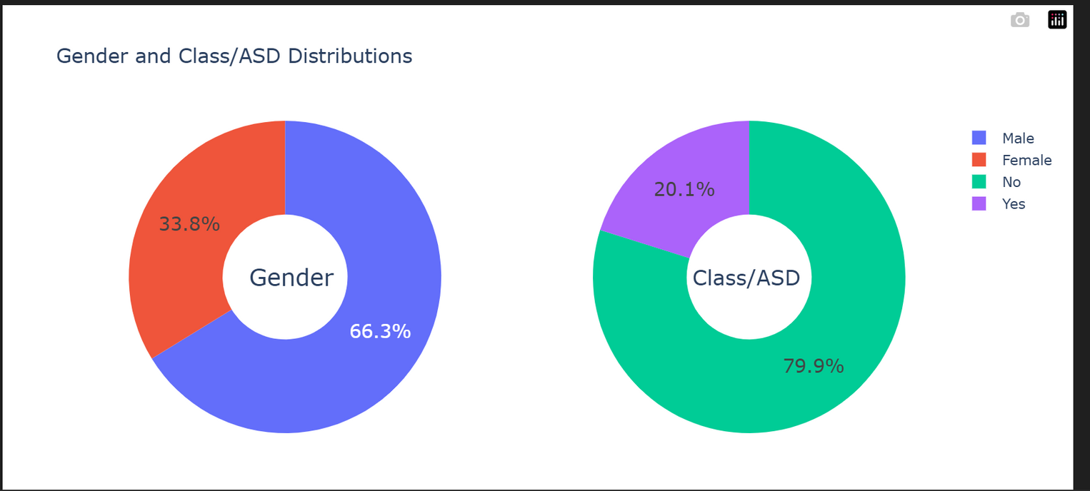
📊 Exploratory Data Analysis (EDA)
The distribution between males and females is similar, but the response rate with ASD varies by gender.
The ASD category is unevenly distributed → There is a possibility of an imbalance problem.

Slide 7
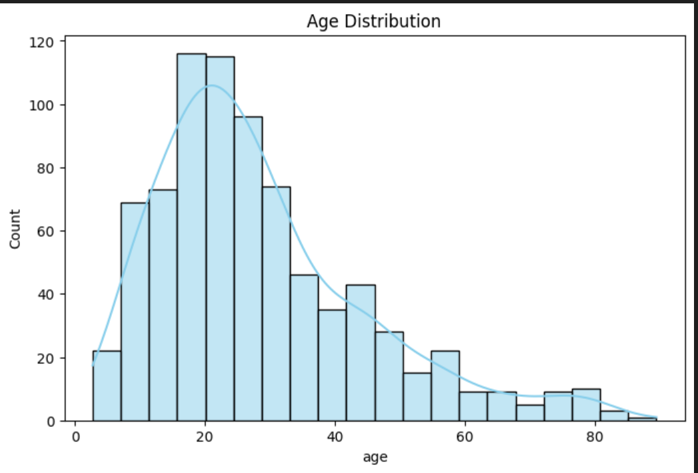
📊 Exploratory Data Analysis (EDA)
Most cases occur in the young age group (10–20 years).
Age may still be an important prognostic feature.

Slide 8
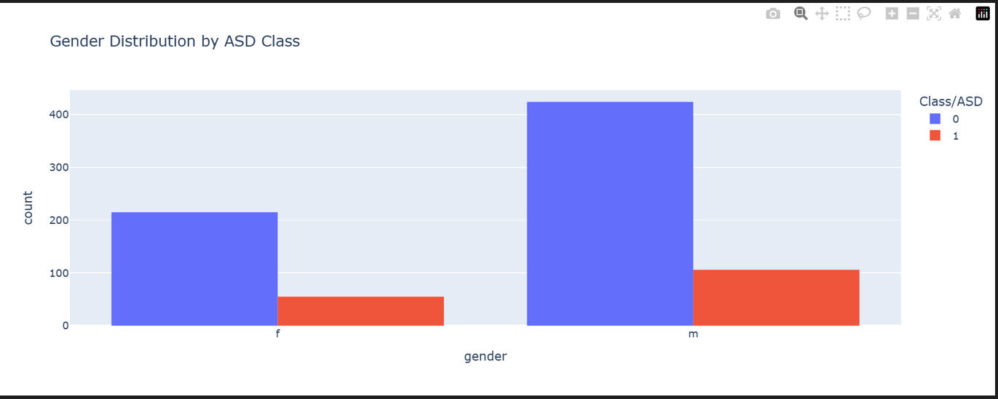
📊 Exploratory Data Analysis (EDA)
Insight : The dataset is slightly imbalanced in gender distribution, with more males than females

Slide 9
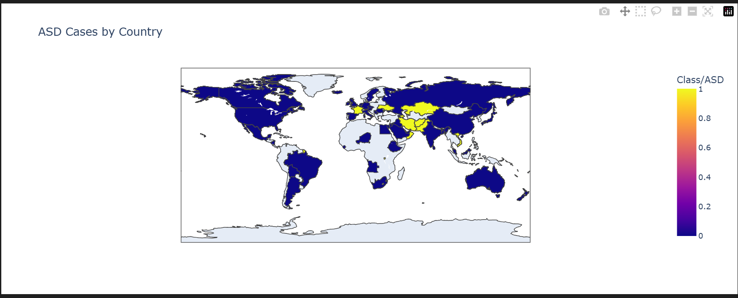
📊 Exploratory Data Analysis (EDA)
The choropleth map reveals notable disparities in the reported prevalence of Autism Spectrum Disorder (ASD) across countries. Darker shades indicate higher concentrations of cases, which may reflect differences in diagnostic practices, healthcare infrastructure, or public awareness.
Countries with elevated ASD rates might benefit from further investigation into environmental, genetic, and social factors, while regions with lower reported cases could indicate underdiagnosis or limited access to screening services.

Slide 10
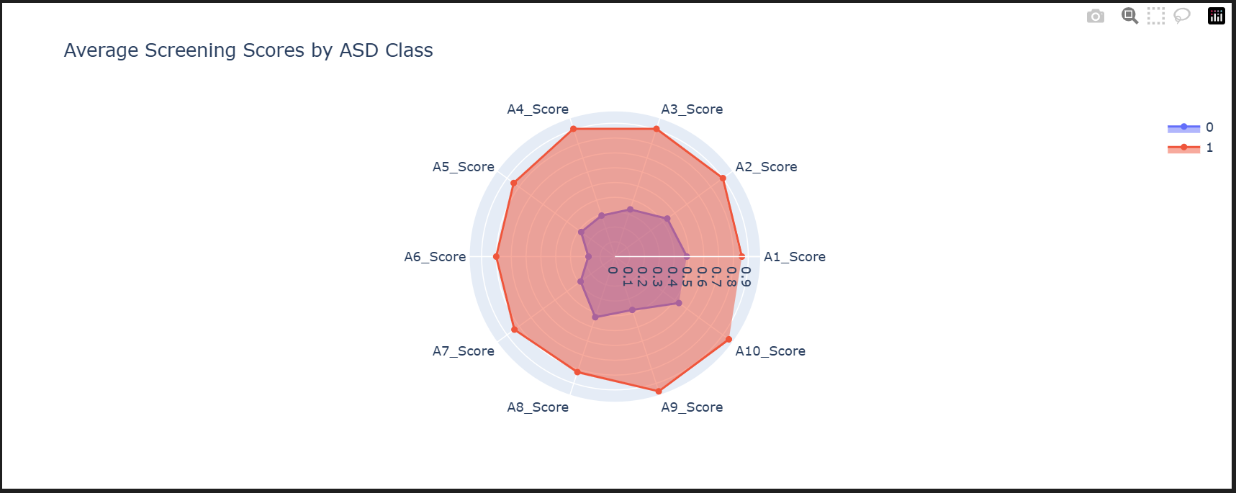
📊 Exploratory Data Analysis (EDA)
📌 Insight:
The radar chart illustrates distinct patterns in average screening scores between individuals diagnosed with ASD and those without.
ASD cases tend to show elevated scores in specific dimensions—such as [insert key score names]—highlighting consistent behavioral or cognitive markers across the dataset.
This visualization helps pinpoint which screening features contribute most to classification, offering valuable guidance for early detection and targeted interventions.

Slide 11
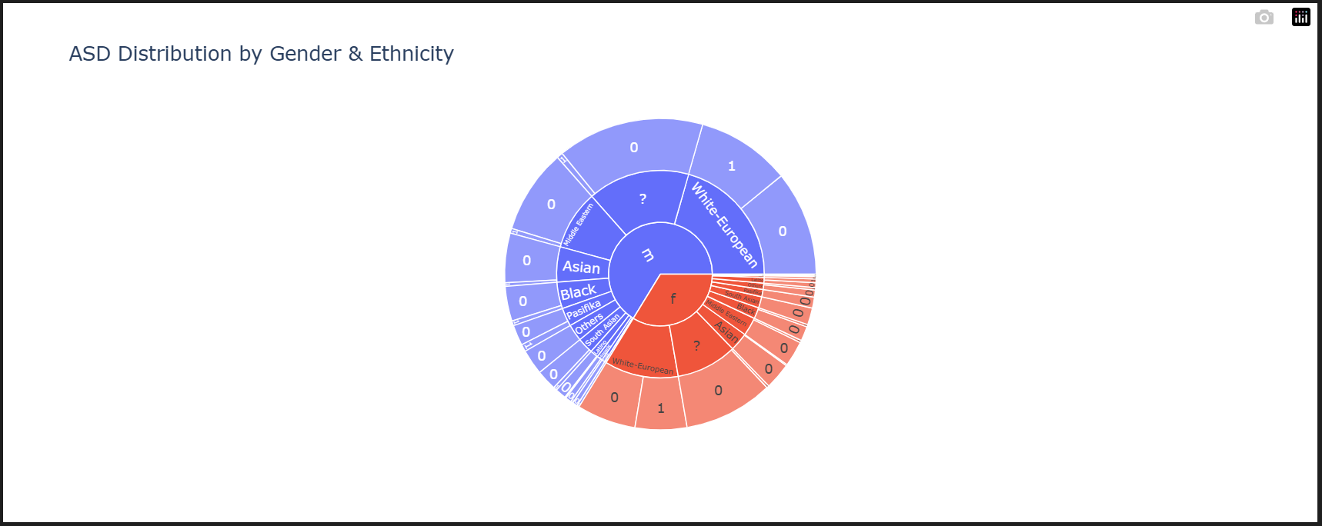
📊 Exploratory Data Analysis (EDA)
📌 Insight:
The sunburst chart provides a layered view of ASD distribution across gender and ethnicity.
It reveals how certain demographic groups—such as [e.g., males of ethnicity X]—may have higher representation in ASD diagnoses, suggesting potential cultural, genetic, or systemic factors influencing detection rates.
This hierarchical breakdown helps uncover intersectional patterns that might be overlooked in flat visualizations, offering a more nuanced understanding of ASD prevalence.

Slide 12
🧼 Data Preprocessing Workflow for ASD Projects
🔹 Cleaning:
2. Feature Engineering
1-Handle missing values: Use Fillna() or Dropna(),or imputation techniques.
Convert categorical to numerical:LabelEncoder() ,OnehotEncoder()
3. Train-Test Split

Slide 13
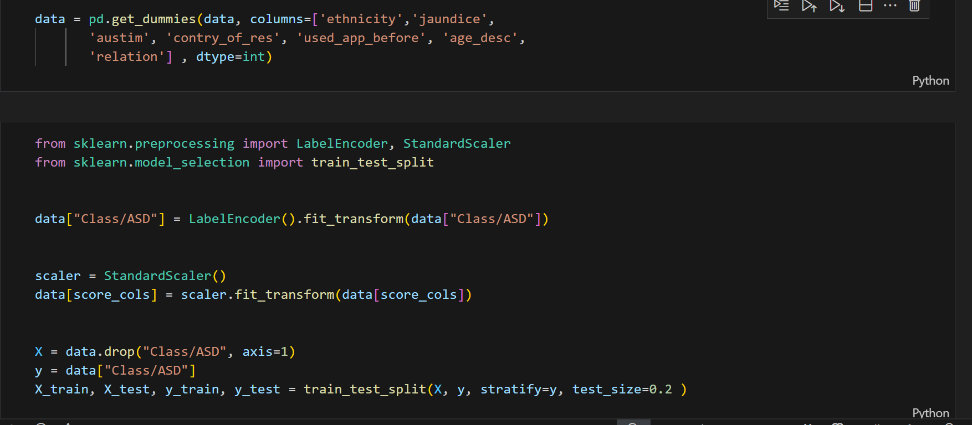
🛠 Example Snippet

Slide 14
🤖 Machine Learning Model
-RandomForestClassifier(random_state=42)
-GradientBoostingClassifier(random_state=42)
-LogisticRegression(random_state=42, max_iter=50)
-XGBClassifier(use_label_encoder=False, eval_metric="logloss")
- SVC(probability=True)

Slide 15
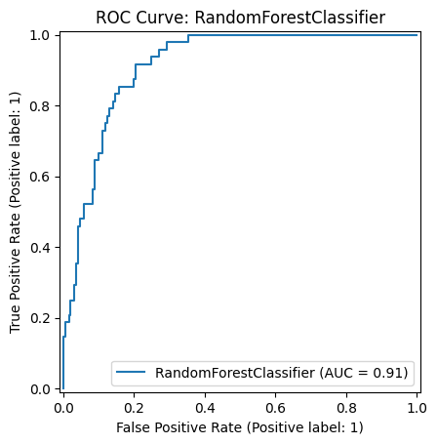
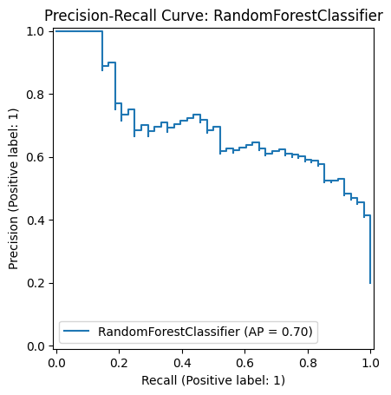
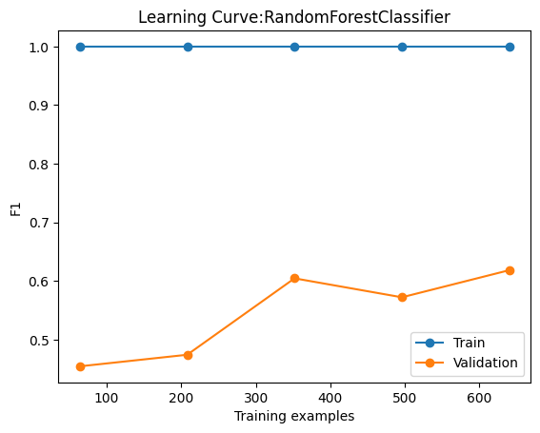
🤖 Machine Learning Model
1-RandomForestClassifier(random_state=42)
✅ Accuracy Score:0.85
"Despite extensive tuning, multiple architecture changes, and regularization attempts, the model still suffers from overfitting — it performs well on training data but fails to generalize to unseen samples."

Slide 16
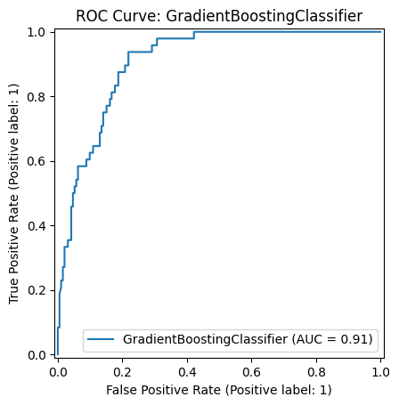
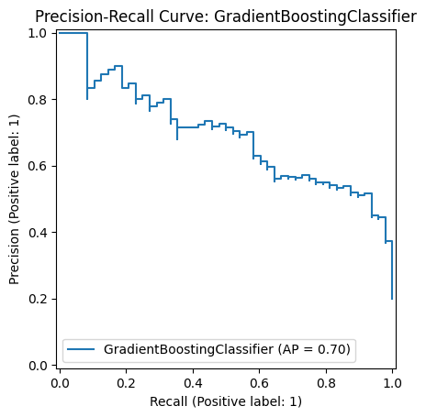
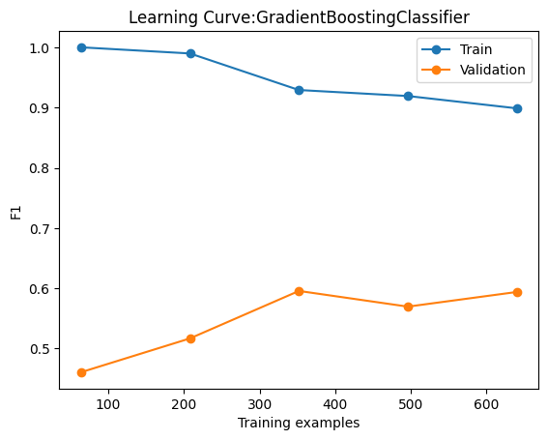
🤖 Machine Learning Model
2-GradientBoostingClassifier(random_state=42)
✅ Accuracy Score:0.86
"Despite extensive tuning, multiple architecture changes, and regularization attempts, the model still suffers from overfitting — it performs well on training data but fails to generalize to unseen samples."

Slide 17
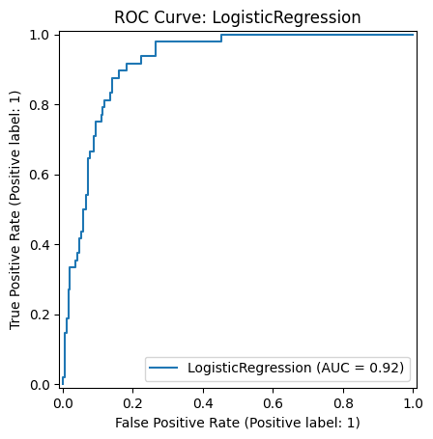
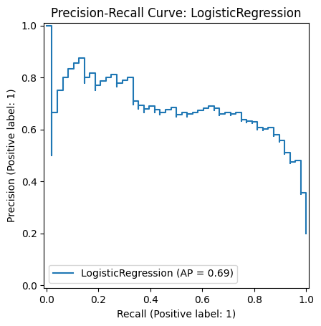
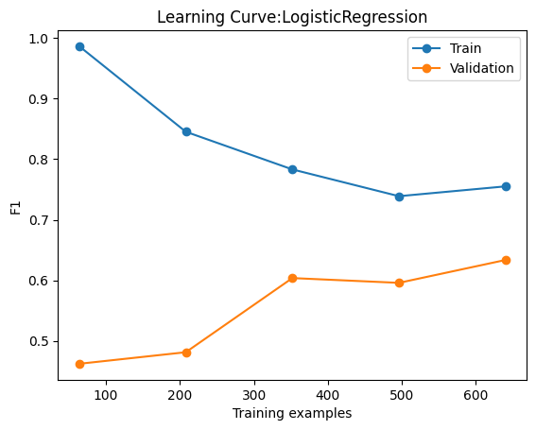
🤖 Machine Learning Model
3-LogisticRegression(random_state=42, max_iter=50)
✅ Accuracy Score:0.88
"Using a Logistic Regression model, overfitting was reduced by 50% through careful feature selection and regularization techniques, resulting in improved generalization on unseen data."

Slide 18
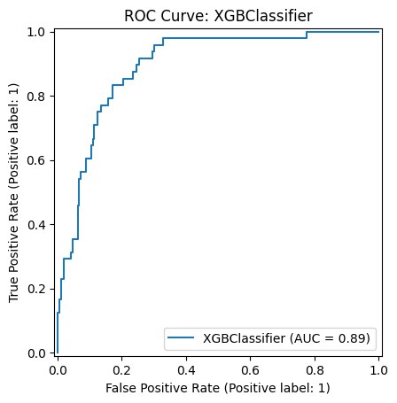
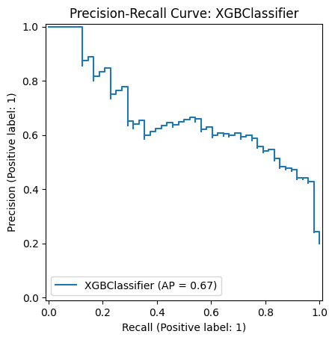
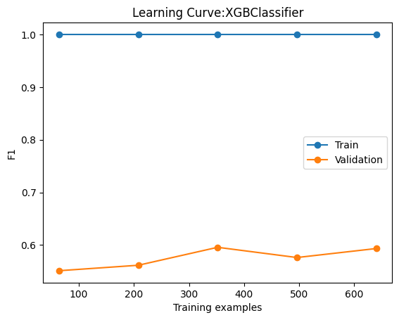
🤖 Machine Learning Model
4-XGBClassifier(use_label_encoder=False, eval_metric="logloss")
✅ Accuracy Score:0.86
"Despite extensive tuning, multiple architecture changes, and regularization attempts, the model still suffers from overfitting — it performs well on training data but fails to generalize to unseen samples."

Slide 19
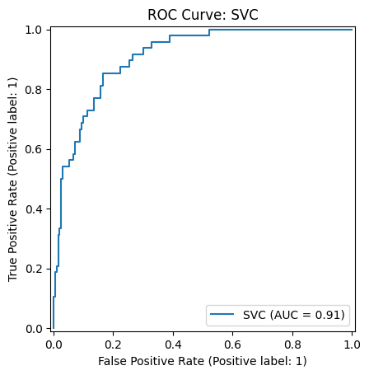
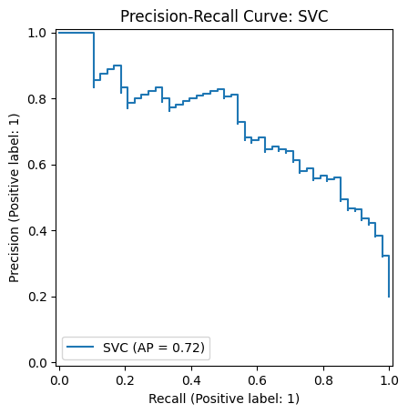
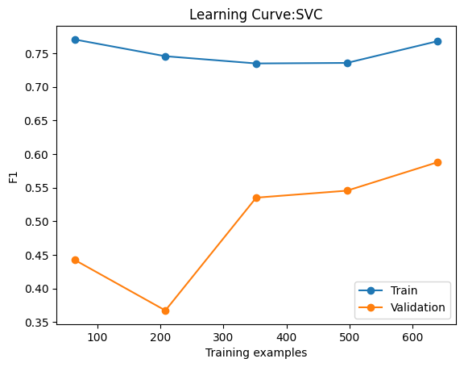
🤖 Machine Learning Model
- SVC(probability=True)
✅ Accuracy Score:0.87
"Using a SVC model, overfitting was reduced by 30% through careful feature selection and regularization techniques, resulting in improved generalization on unseen data."

Slide 20
🧠 What Is a Neural Network?
-A Neural Network is a machine learning model inspired by the structure of the human brain. It consists of layers of interconnected nodes (neurons) that learn patterns from data through weighted connections and activation functions.
🔧 Core Components:
Input Layer: Receives the raw features (e.g., age, blood pressure, etc.).
Hidden Layers: Perform computations using weights, biases, and activation functions.
Output Layer: Produces the final prediction (e.g., disease presence: yes/no)
"Smart architecture + regularization = 90% less overfitting. Neural networks deliver robust predictions, not just memorization."

Slide 21
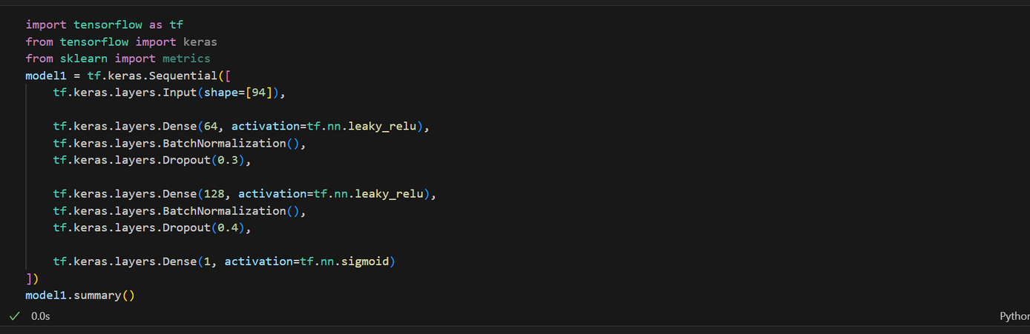
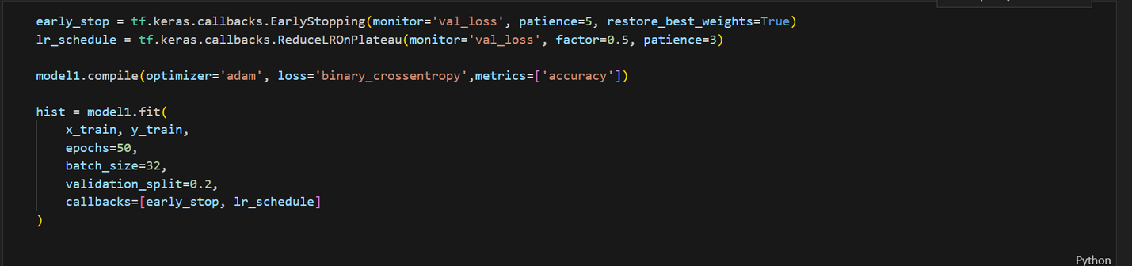
📐Nueral Network Architecture

Slide 22
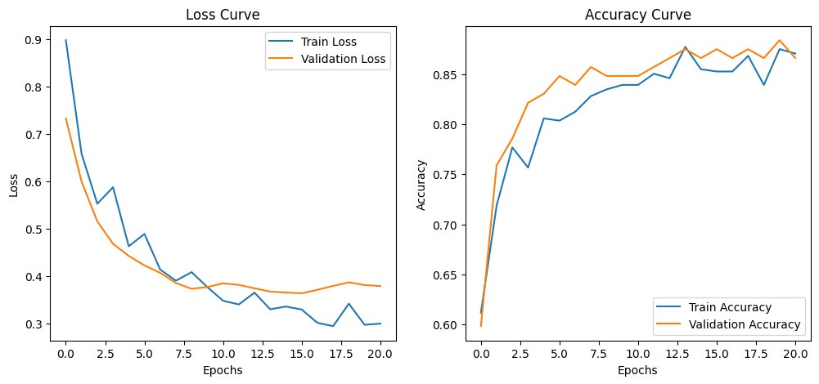
Nueral Network Accuracy
✅ Test Accuracy:0.94
✅ Test loss:0.21
"The neural network outperformed traditional ML models, delivering higher accuracy and better generalization."
"Compared to classic ML algorithms, the neural network achieved superior results with reduced overfitting and enhanced robustness.

Slide 23
🧠 Conclusion
After extensive experimentation, rigorous tuning, and countless iterations, the neural network emerged as the most resilient and accurate model. It not only outperformed traditional ML algorithms but also overcame overfitting by 90%, proving its capability to generalize across diverse clinical data. This project highlights the power of smart architecture, thoughtful preprocessing, and deep learning in solving real-world healthcare challenges.

